Slide 1
Methods & Other Stuff
by annemarie caballero
I.T. Girls august 13-17

Slide 2
Method header
public static void main (String[] args) {
…
}
access
we’re not worrying about it right now
return type
method name
parameters
{} – beginning and ending of method

Slide 3
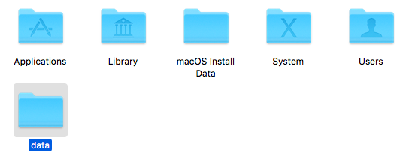
What’s a directory?
A folder!
Old MacDonald had a farm (with print statements).

Slide 4
Functions vs. procedures
Function – a method that returns a value
Examples:
Adding two variables
Checking if two words are the same
Procedure – a method that completes an action
Examples:
Print with a certain format
Main method

Slide 5
WHY USE ADDITIONAL METHODS?
}
Organization
Don’t put all your code in main
Comprehensibility
Important to have specific titles
Minimizing repetition
Faster and more readable
Reusable (do less work)
The best part
Easier to debug and test

Slide 6
Syntax Vs. Style
SYNTAX – rules for how you format code
IMPORTANT INFO:
end every line with a ;
System.out.println(“yikes”);
some words are reserved, so don’t use them as names
final
make sure all your curly braces are closed
{}
comments are written using // or /* */
some characters (like the backslash and quotation marks) if you want to print them need to be written like “\\” and “\””
STYLE – how you should format code
IMPORTANT RULES:
all Java names (except the class name) should have a lowercase first word and capitalize the rest of the words
String helloWorld = “Hello World”;
Called camelcase

Slide 7
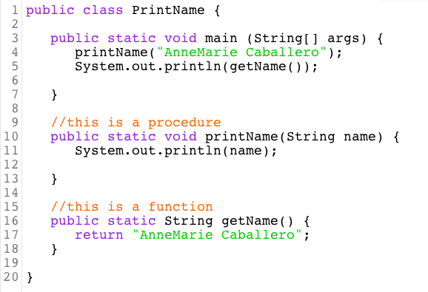
Calling a method
Calling - when you use(run, execute) a method inside another method

Slide 8
Common Compiler errors
HelloWorld.java:10: error: ';’ expected – missed a ;
HelloWorld.java:13: error: reached end of file while parsing – need to close {}
No main methods alert - syntax of main’s method header is wrong
HelloWorld.java:7: error: class Helloworld is public, should be declared in a file named Helloworld.java – class name different from file name
HelloWorld.java:7: error: class, interface, or enum expected – did not put main method in a class
HelloWorld.java:10: error: not a statement – generally bad
HelloWorld.java:10: error: ')’ expected - didn’t close parentheses
HelloWorld.java:10: error: unclosed string literal – didn’t close quotation marks
HelloWorld.java:10: error: cannot find symbol – used a method name or variable that doesn’t exist

